Slide 1
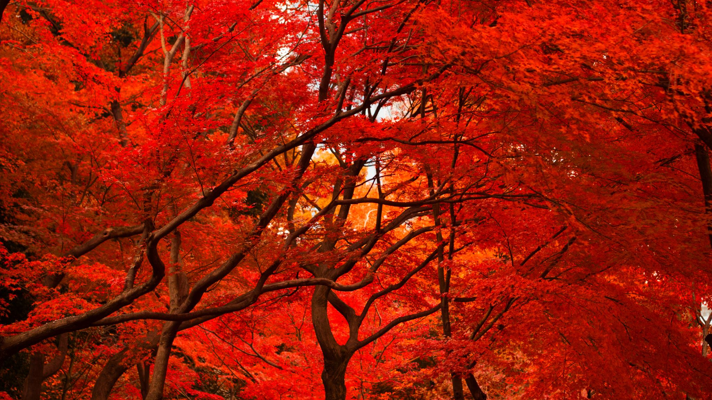
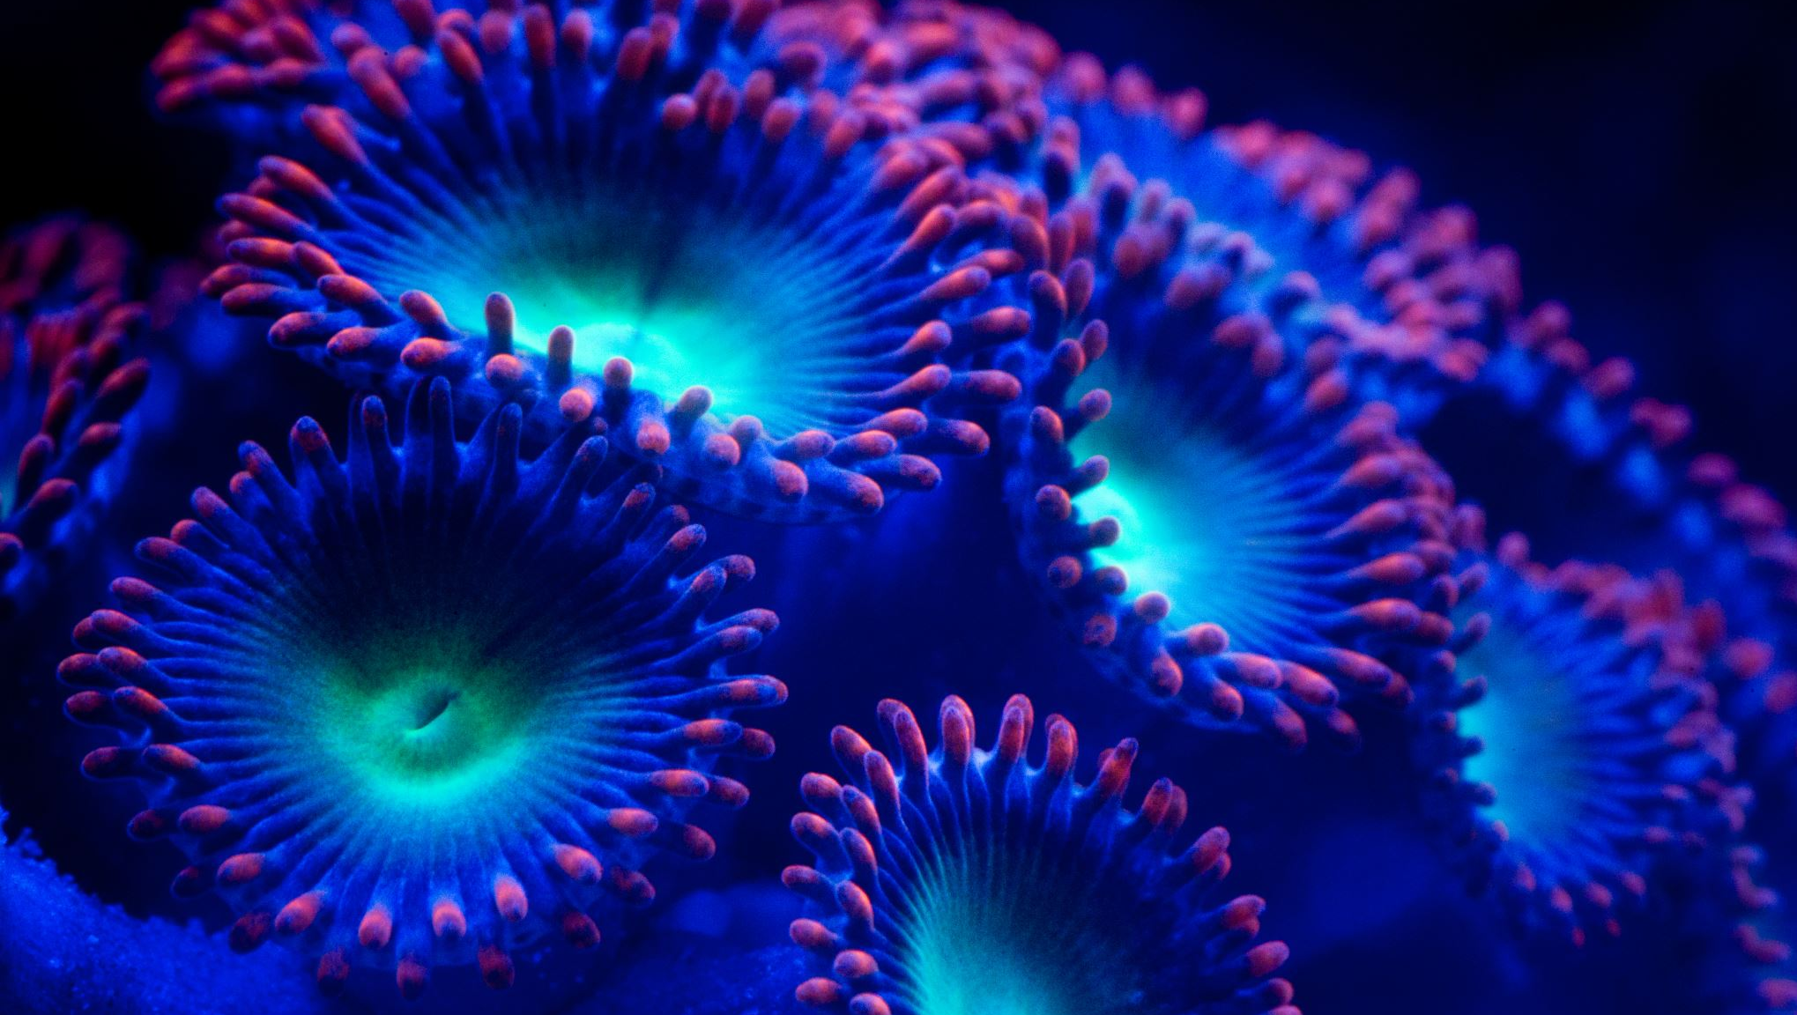

Slide 2
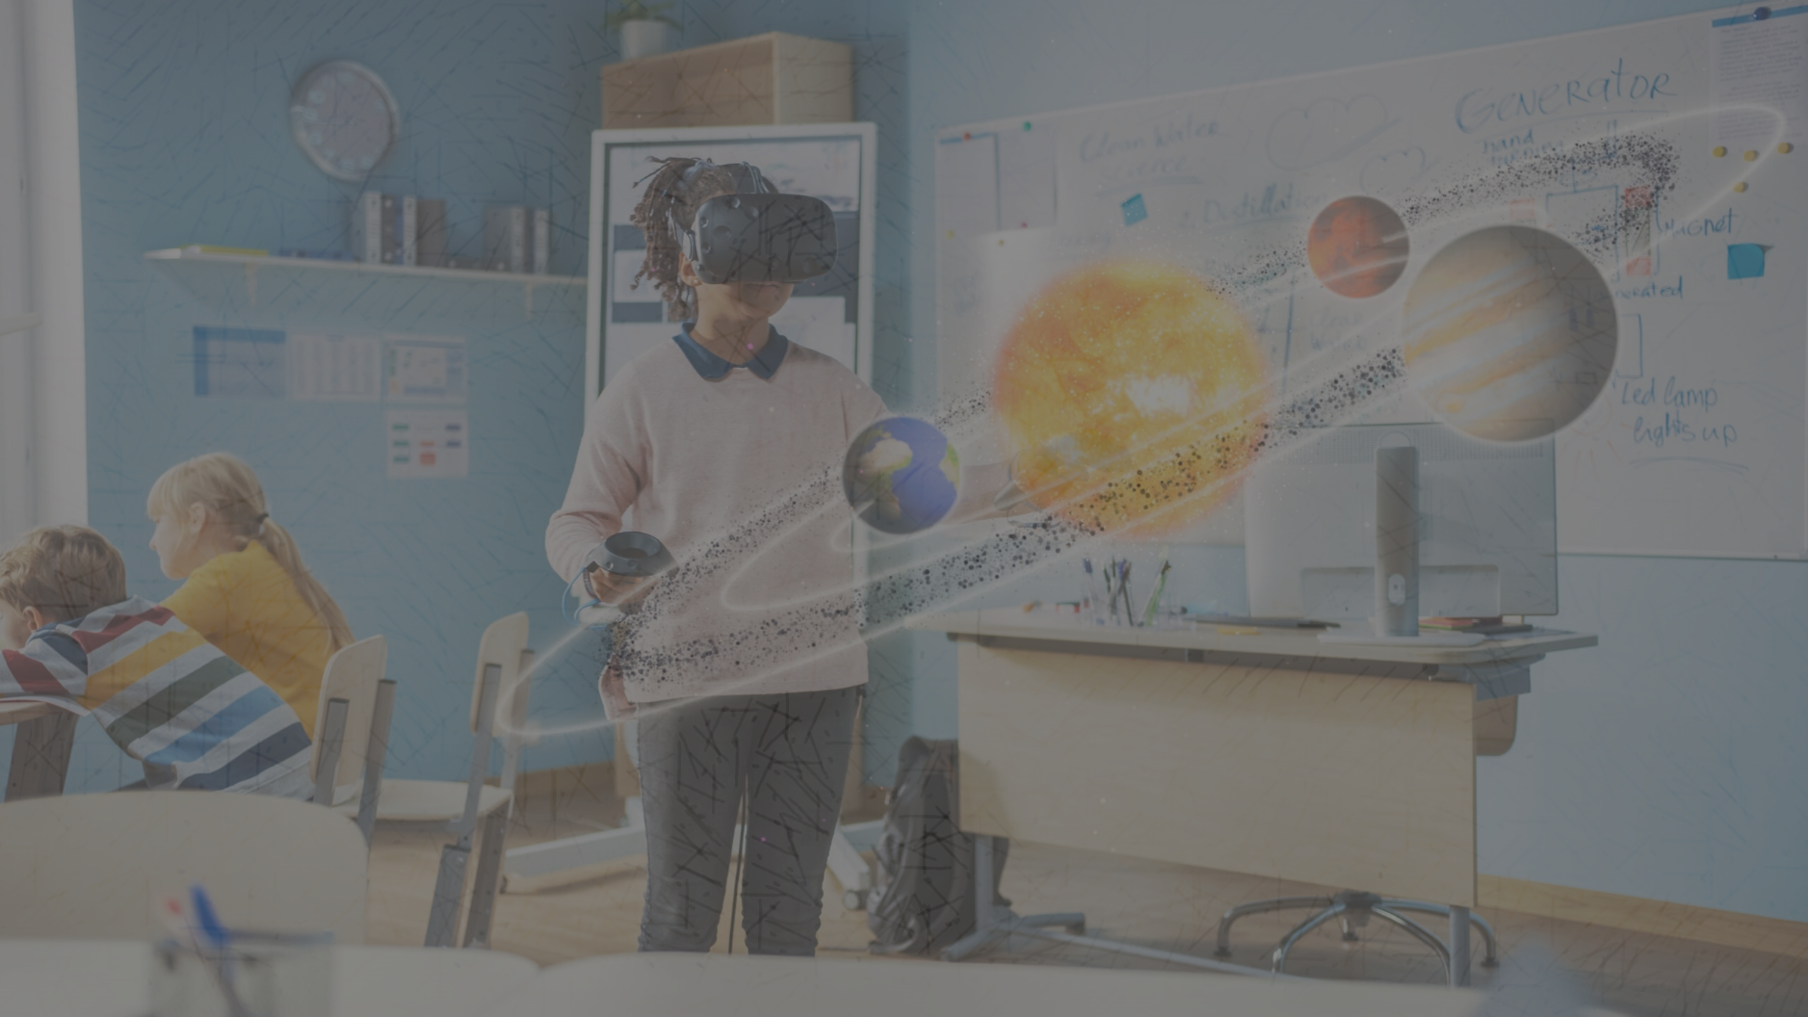

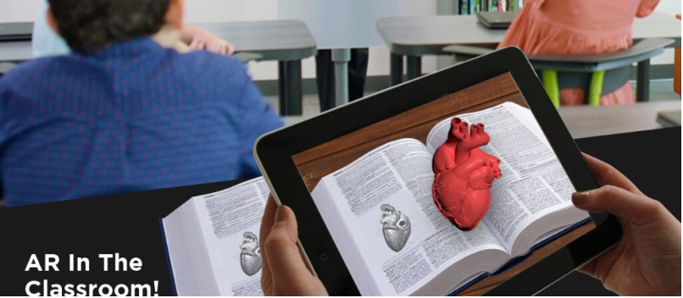
A Project presentation on
ImagiAR for Child Education
Made by:
1) Tushar Mungekar (38) 2) Avishkar Patil (48) 3) Prachi Patil (49) 4) Harshal Pendse (51)
Under the Guidance of:
Prof . Amita Raman
Department of CSE(Artificial Intelligence and Machine Learning)

Slide 3
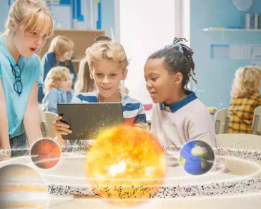
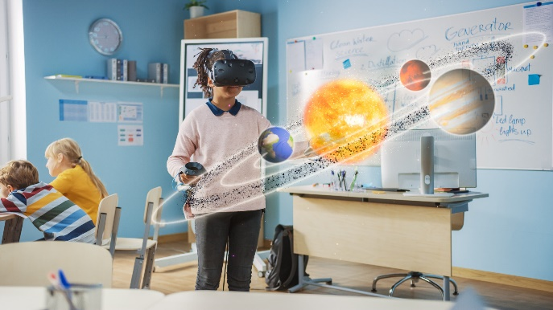
Table of Contents
Introduction
Literature survey
Problem statement
Proposed system
Methodology
Dataset to be used
Performance Evaluation Parameters
Evaluation
Result
Future work
References
Department of CSE(Artificial Intelligence and Machine Learning)

Slide 4
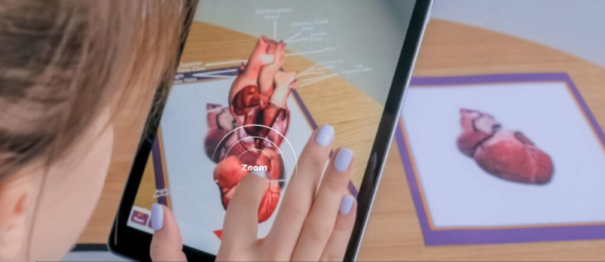
Introduction
ImagiAR pioneers a transformative approach to education through the power of Augmented Reality (AR), facilitating profound understanding of intricate subjects by immersing students in vivid 3D representations. Our commitment extends beyond traditional learning paradigms.
we strive to empower learners of all backgrounds and abilities, particularly those with autism, by providing them with intuitive tools to grasp abstract concepts effortlessly. With ImagiAR, education transcends boundaries, unlocking new avenues for exploration and comprehension in the classroom and beyond.
Department of CSE(Artificial Intelligence and Machine Learning)

Slide 5

Problem statement
Traditional educational methods often struggle to effectively engage students, particularly those grappling with complex concepts or learning disabilities like autism spectrum disorder (ASD). Static diagrams, a staple in teaching, can present significant barriers to understanding, especially for these students.
To address this challenge, our project aims to develop an Augmented Reality (AR) educational application. This app will dynamically animate diagrams in real-time, offering an immersive learning experience that enhances comprehension and aids in retention.
Department of CSE(Artificial Intelligence and Machine Learning)

Slide 6
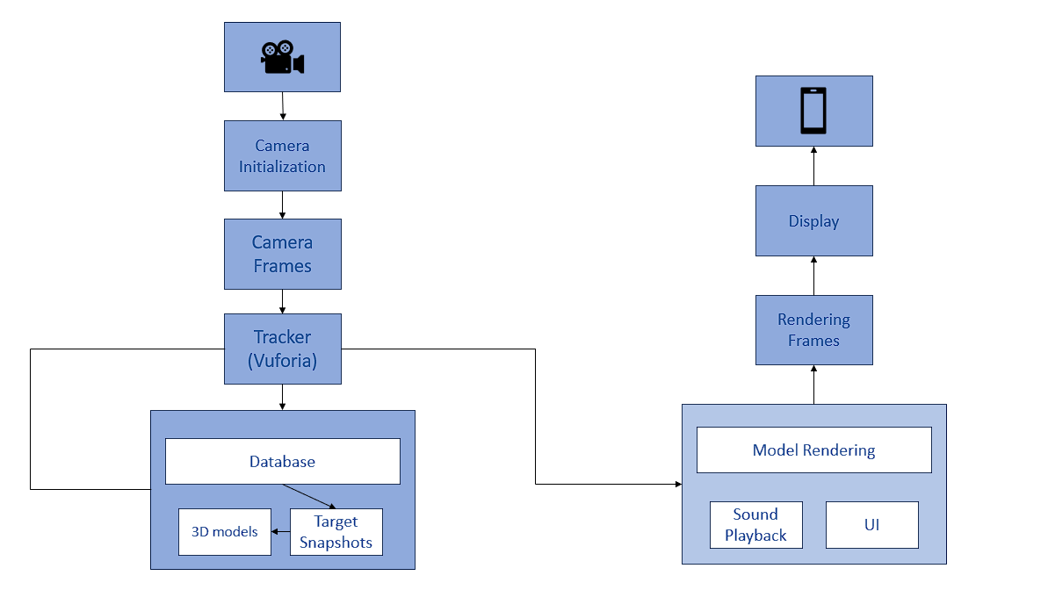
Proposed System
Department of CSE(Artificial Intelligence and Machine Learning)

Slide 7
Methodology
AR development : Unity environment for creating augmented reality experiences across various platforms.
Marker based object tracking: Marker-based object detection using Vuforia Engine by recognizing and tracking physical markers to overlay digital content on them in real-time.
Android Development : Android SDK, A set of tools and libraries for developing Android apps. JDK, to compile and run Java code integrated in the app.
3D assets : Blender, A free and open-source 3D creation suite.
Department of CSE(Artificial Intelligence and Machine Learning)

Slide 8
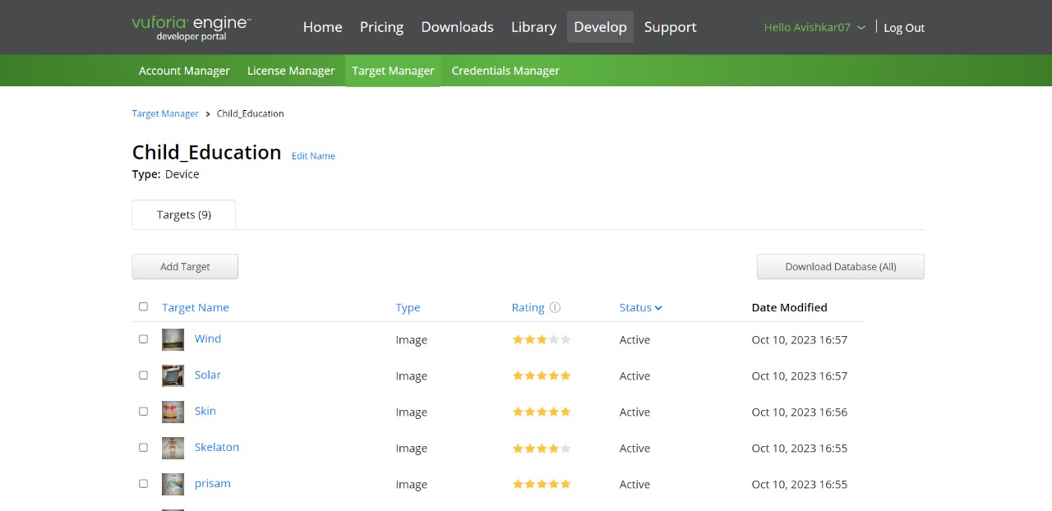
DATA SET
Vuforia datasets also referred as image targets, which is used to recognize specific targets or objects in real world.
Department of CSE(Artificial Intelligence and Machine Learning)

Slide 9
Performance evaluation parameters
Response time : Response time in Vuforia engine depends upon several factord like Hardware and the quality of image.
Frame rate : Vuforia produces average of 60 FPS. (Fluctuates between 40 to 60 depending on hardware)
Accuracy : Accuracy of the engine depends on the quality of images provided in the Vuforia dataset
Department of CSE(Artificial Intelligence and Machine Learning)

Slide 10
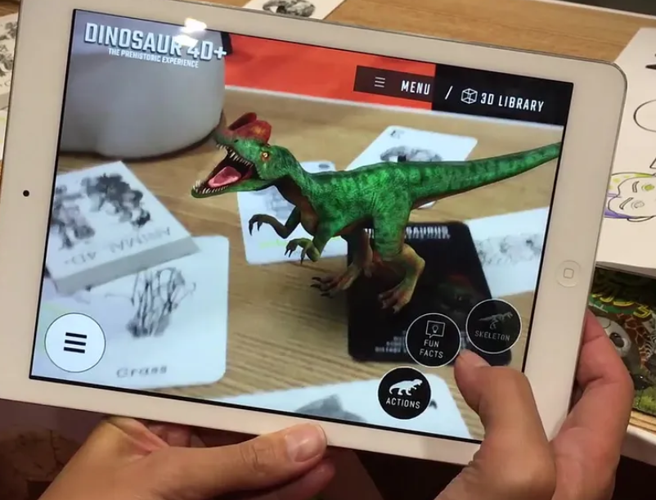
Evaluation
Used Ambient sound plugin to improve Audio playback after target detection
Optimized target image dataset improving better target detection (Accuracy) for the app.

Slide 11
Evaluation
Evaluation
Used Google AR Core XR plugin's optimized rendering pipeline to overcome black screen encountered during app launch, significantly improving user experience.
App Response time before implementation of XR plugin | App Response time after implementation of XR plugin
~ 10-15 Seconds | ~ 1-2 Seconds
Department of CSE(Artificial Intelligence and Machine Learning)

Slide 12
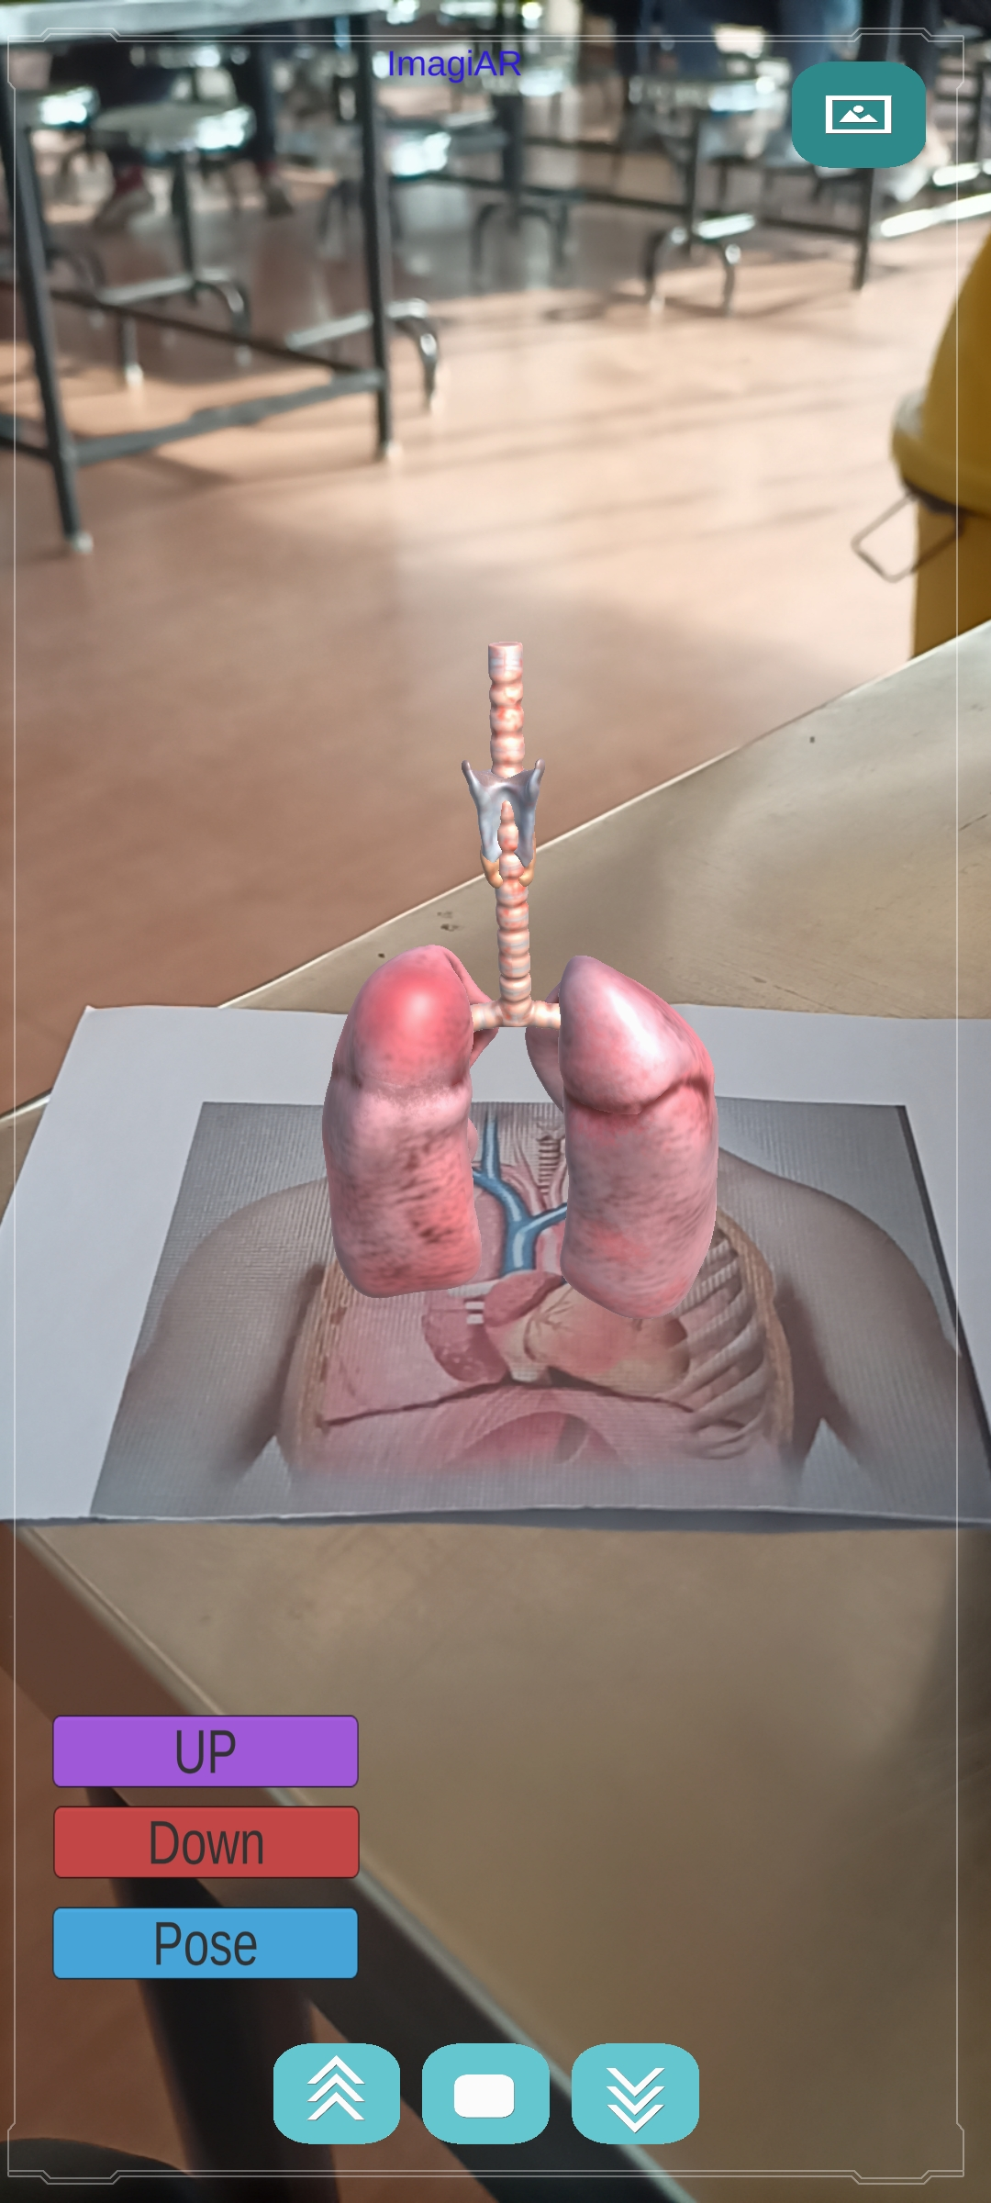
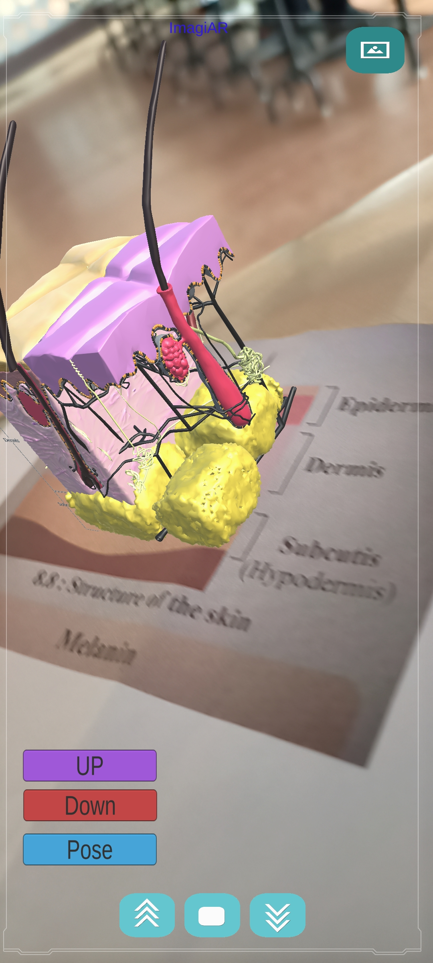
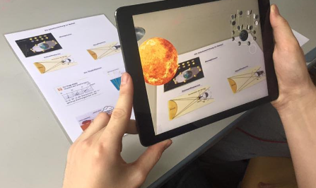
RESULT
Department of CSE(Artificial Intelligence and Machine Learning)

Slide 13


